Slide 1
Child Support System Project Update
October 21, 2019
Notes:
Talking Points:
Introduce yourself again.
You will see CSS throughout the presentation. That is just a placeholder. As you all know, we held a statewide contest to name the system. The winner will be announced on Wednesday morning so make sure you are here. We are looking forward to sharing the new name.
This system build is truly a team effort.
Introduce the team is Kevin doesn’t do so previously.
Liaisons - Ray Stewart, Nadine Countess, Bob Ozmah, Cindy Shockey and our historian Sue Pistorio who retired at the end of September
Special Thank you Erin Easton who has been the backbone of the project.
MD Think SMEs, MD Think Technical Team, OCM Team, and most importantly the Local SMEs, please stand if you are on a workgroup or have had to fill in while a SME has been out working on the system. You all are what make the difference.

Slide 2

The Child Support System Vision
“A technologically-advanced, holistic approach for delivering child support services to ensure that our top priority remains the financial security of children and their families.”
Notes:
Kevin’s full Vision Statement for the new system will be released this week, but we thought it was important to provide you with at least a piece of that vision when giving you an overall update.

Slide 3
Streamlined Functions & Speed
Worker Portal
Automated features and functions empower caseworkers to expedite the case intake process, establish and enforce child support orders more efficiently, manage funds, collect outstanding arrears and reduce instances of fraud.
Consumer Portal
CSS makes it easier for custodial parties to apply for child support, and offers noncustodial parties a simpler way to make support payments and settle arrears.
Notes:
Streamlining is an extremely important part of our system build. Putting all 4-5 of the currently Siloed systems into one place is only the start. We are working to make sure the system works for you instead of you building work arounds to supplement the system.

Slide 4

CSS Proposed Timeline
User Acceptance Testing
Phase 1 & 2 Certification
Winter 2019
Spring 2020
Summer 2020
Summer - Fall 2020
Winter 2020
CSS Module Coding completed
Pilot/Federal Cert. Process begins
Federal Certification/
CSS Statewide Rollout
Pilot Hands-on Training
Hands-on Training
Department of Human Services - Child Support System (CSS)
Notes:
We gave you this timeline to show what our end goal is, and what broad activities will take place over the year.

Slide 5
Consumer/Employer Portal Modules (Completed)
      Interactive Map for All Child Support Offices
      Secured Login Using Identity Access Management (IAM)
      Rules Engine for Screening
      Online Application
      SmartyStreet Address Validation
      Interface with NIC Application Fee Payment
      Document Upload (Enterprise Content Management System)
      Instant Application/Case Status Notification
      Employer Notification (IWO, NMSN)
      Report Employee Termination
Notes:
I won’t go over each item or we will be here all day. So I will pick a few:
Rules Engine for Screening - This additional screening helps to ensure that when customers are online they are truly applying for the services that they need. We also recognize that some of customers will be better served in person. This feature will help direct them to the right place and will cut down frustration/confusion.
SmartyStreets - This is a simple tool, but an important one. It provides real time address validation. This is not a locate tool, but at least we will know right away if an address is real and can help cut down on data entry errors.
ECMS Document Upload - Customers will be able to login and upload all of their documentation from home. This saves time and effort for those applying for child support. All information uploaded will be able to be associated with cases that member is associated with which will also help us to keep better records.
The Employer Portal is a new feature all together. We wanted a place where employers could log in and directly update their company information or even report information to us such as terminations.

Slide 6
Worker Portal Modules
Completed:
Fully integrated with MD THINK platform components
  Identity Access Management (IAM)
  Shared Data Repository (SDR)
  Master Data Management (MDM)
  Enterprise Content Management System (ECMS)
Interfaces
  Federal Parent Locator Services (FPLS)
  Federal Case Registry (FCR)
  Query for Interstate Cases for Kids (QUICK)
  CSENet
  State Licensing Agencies (XX)
  Division of Vital Records (DVR)
Application Components
  Dashboard Module and Widgets
  Case Intake Module (IV-D and Referral)
  Locate module
  Case Management
Notes:
We will be working on providing E-Learning opportunities to you prior to the system release. We realize that a part of the anxiety of moving to a new system comes with not fully understanding the pieces that make up the new system. So our hope is to help lessen that anxiety by giving you short videos to watch at your leisure that explain topics like MDM and SDR.

Slide 7
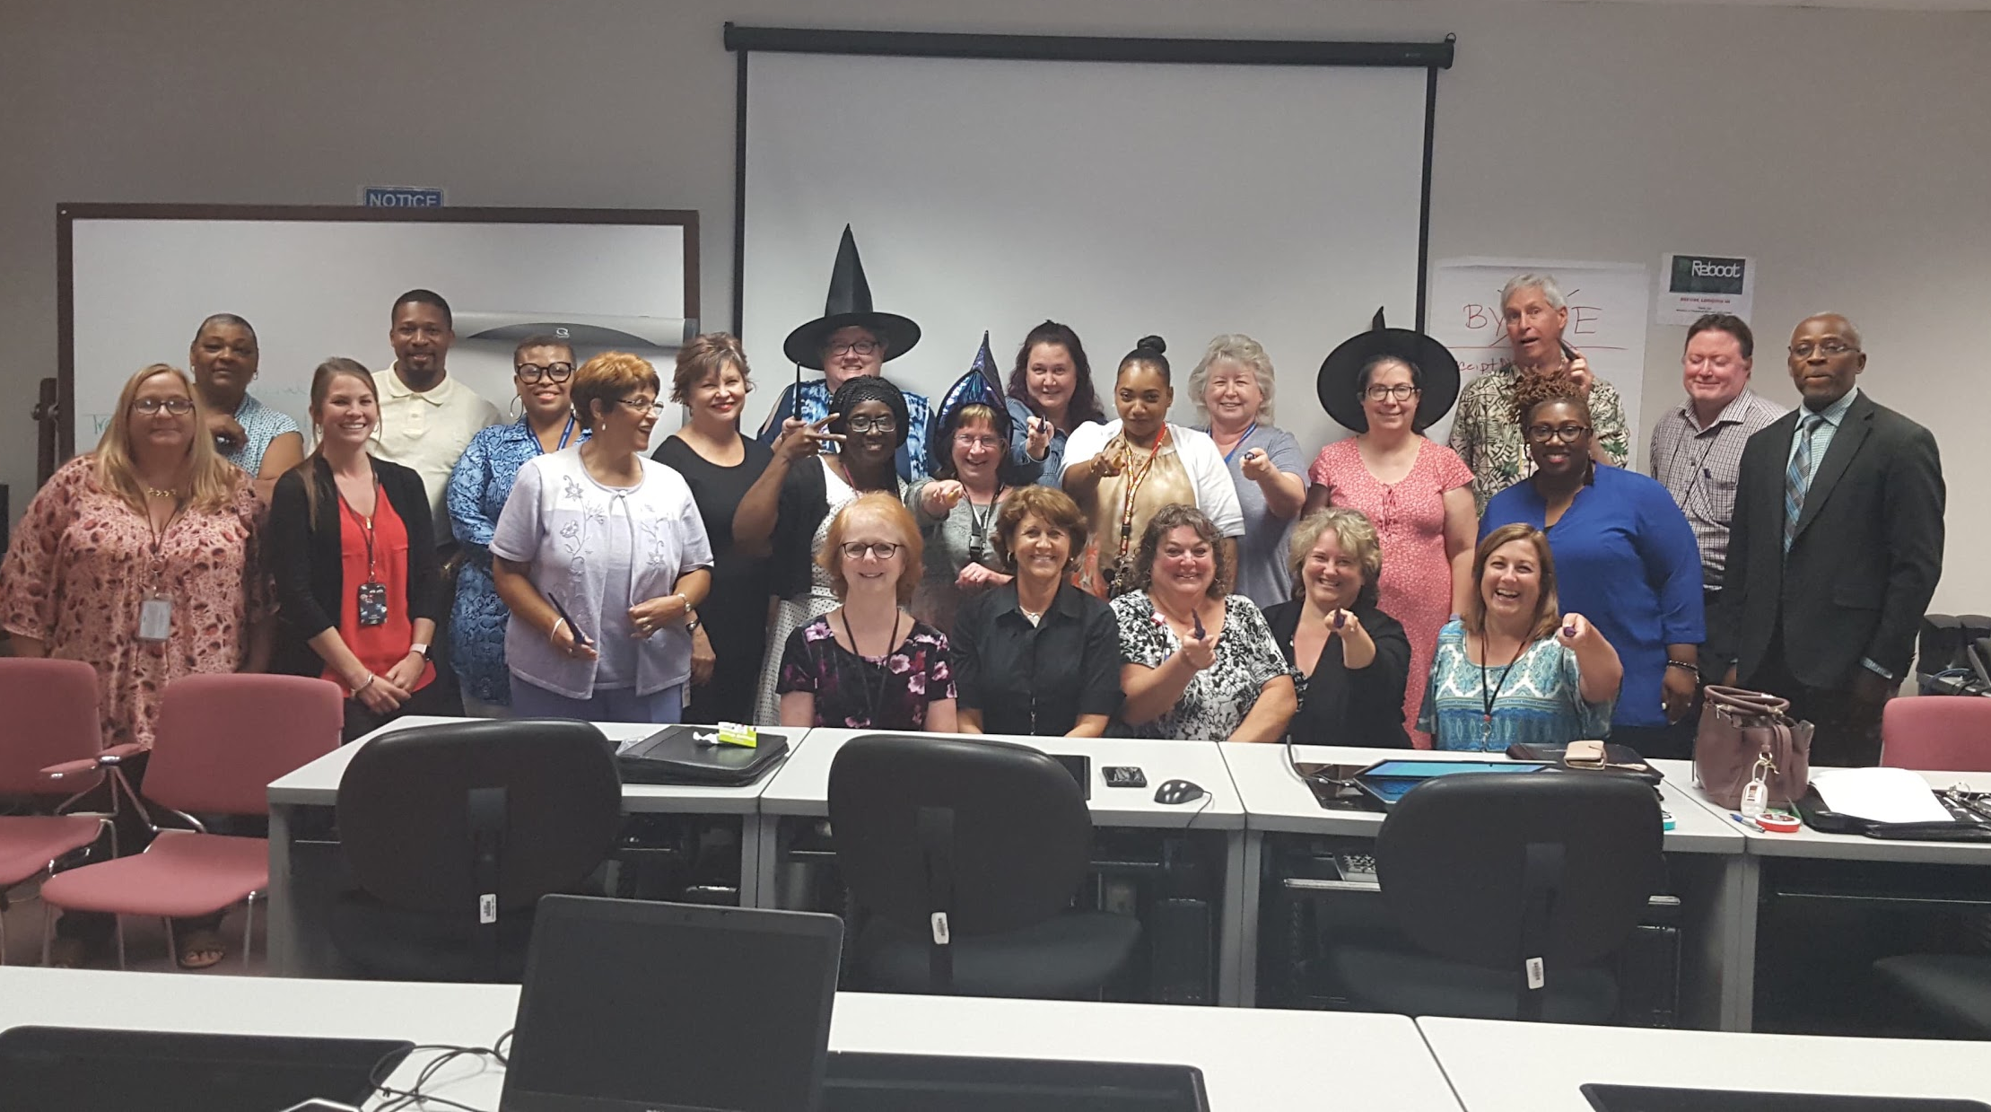
Worker Portal Modules
In Progress:
Establishment Module & Associated Interfaces
Enforcement Interfaces for Income Garnishment and Income Intercept
Enforcement Interfaces for License Suspension
Notes:
The Financial Module is also in development, which is pictured here is the League of Financial Wizards.
Establishment, Enforcement, and Financials have been the largest focus over the past 6 months as they are some of the most crucial modules in the system.

Slide 8

Additional Services & Framework (Completed)
Notification Framework
Document Generation Framework
Role Based Access Control Framework
Case Action Log
User Audit Trail
Contact Support & Alert Functions
Corticon - Guidelines Calculator
Notes:
This framework has been some of the most complicated topics. The outcome looks simple, but they truly support a large portion of the system.
For example Role Based Access (RBAC) This has been a huge topic since we know that a Metro office operates very differently than a small county. So the RBAC has to be flexible enough to cover our needs statewide.
Corticon is our Rules Engine, which allowed our team to build the Guidelines Calculator into the system which is a Federal Certification Guideline, but will also be a time saver for our team members. Don’t worry it matches SASSY CALC.

Slide 9
Questions
?
Notes:
For all questions Please see Victor...that’s what I do. I will be around to answer any follow up questions. Also please feel free to reach out to me after the conference.

